Slide 1
Disclosures

Slide 2
Only RISC-V Members May Attend
Non-members are asked to please leave except for Joint Working Groups (JWG).
Members share IP protection by virtue of their common membership agreement. Non-members being present jeopardizes that protection. Joint working groups (JWG) agree that any IP discussed or worked on is fully open source and unencumbered as per the policy.
It is easy to become a member. Check out riscv.org/membership
If you need work done between non-members or or other orgs and RISC-V, please use a joint working group (JWG).
used to allow non-members in SIGs but the SIGs purpose has changed.
Please put your name and company (in parens after your name) as your zoom name. If you are an individual member just use the word “individual” instead of company name.
Non-member guests may present to the group but should only stay for the presentation. Guests should leave for any follow on discussions.

Slide 3
Antitrust Policy Notice
RISC-V International meetings involve participation by industry competitors, and it is the intention of RISC-V International to conduct all its activities in accordance with applicable antitrust and competition laws. It is therefore extremely important that attendees adhere to meeting agendas, and be aware of, and not participate in, any activities that are prohibited under applicable US state, federal or foreign antitrust and competition laws.
Examples of types of actions that are prohibited at RISC-V International meetings and in connection with RISC-V International activities are described in the RISC-V International Regulations Article 7 available here: https://riscv.org/regulations/
If you have questions about these matters, please contact your company counsel.

Slide 4
Collaborative & Welcoming Community
RISC-V is a free and open ISA enabling a new era of processor innovation through open standard collaboration. Born in academia and research, RISC-V ISA delivers a new level of free, extensible software and hardware freedom on architecture, paving the way for the next 50 years of computing design and innovation.
We are a transparent, collaborative community where all are welcomed, and all members are encouraged to participate. We are a continuous improvement organization. If you see something that can be improved, please tell us. help@riscv.org
We as members, contributors, and leaders pledge to make participation in our community a harassment-free experience for everyone.
https://riscv.org/community/community-code-of-conduct/

Slide 5
Conventions
For one hour meetings, please start at 5 after the start time in order to allow people going to other meetings have time for a short break between meetings. 30 minute meetings start on time.
Unless it is a scheduled agenda topic, we don’t solve problems or detailed topics in most meetings unless specified in the agenda because we don’t often have enough time to do so and it is more efficient to do so offline and/or in email. We identify items and send folks off to do the work and come back with solutions or proposals.
If some policy, org, extension, etc. can be doing things in a better way, help us make it better. Do not change or not abide by the item unilaterally. Instead let's work together to make it better.
Please conduct meetings that accommodates the virtual and broad geographical nature of our teams. This includes meeting times, repeating questions before you answer, at appropriate times polling attendees, guide people to interact in a way that has attendees taking turns speaking, …
Where appropriate and possible, meeting minutes will be added as speaker notes within the slides for the Agenda

Slide 6
Our Charter
There is a growing need for a Zero-Trust architecture in HW, where a software application can both examine and attest to the environment it is running in, and have guarantees that it is isolated from other, untrusted software. The Trusted Computing SIG will examine the state of the art for hardware-assisted technologies such as Confidential Computing, Confidential VM, Remote Attestation, Hardware TEE, Enclaves, Secure Boot, etc., on an ongoing basis, and define the trusted computing strategy for RISC-V. It will develop TG Charters as required, that will define the required written documentation, threat models, executable model, prototype implementations including SW PoCs, toolchain support, and compliance suite for RISC-V trusted execution recommendations and extensions.
https://lists.riscv.org/g/sig-trusted-computing https://github.com/riscv-admin/trusted-computing

Slide 7
Intrinsic Security
RISC-V
Process
Standards Compliance, Security Incidence Response
Security Ecosystem
Firmware,
Software, and
Tools
Clean Slate architecture – learn the lessons of the past
Security as a basic feature of hardware, firmware, software
Royalty Free – democratising innovation
Root-of-Trust, Secure Boot
Confidential Computing
Hardware
Security
Capabilities
Trusted Execution Environment
Memory Protection, Isolation
Crypto Accelleration
Control Flow Integrity
Side Channel Leakage Protection
Embedded
Application
Server
Processor Cores

Slide 8
Roadmap (Work-in-Progress)
Security Model
Ecosystem, Reference implementations, etc.
Application-TEE, Confidential Compute, and Capabilities-Based (AP-TEE)
AP-TEE TG + Cap-based TG(?)
Lightweight TEE
Pointer Masking (J extension)
Memory Tagging
Control Flow Integrity (CFI)
CFI TG(s): Temporal Fencing, and others
Blockchain whitepaper
International Scalar Crypto
Scalar Crypto
Vector Crypto
PQC Crypto
IOMMU within Software HC
IOMMU
S-mode MPU
ePMP
IOPMP
Microarchitectural Side Channel (uSC) leakage mitigations
uSC TG(s)
2021
2022
2023
SIG work
TG work
HC work

Slide 9
Security and RISC-V
RISC-V’s open and clean-slate design presents a unique opportunity to re-think security for the next generation of compute infrastructures.
Become foundation for an Intrinsic Security model
Create robustness against malicious code, bugs, exploits
Enabling Trusted Execution and Confidential Computing – with Zero Trust
Secure App
Secure App
App
App
App
Secure System SW + Runtimes
Trusted OS
Rich OS
Secure Hardware Baseline
Trusted Execution Environment Confidential Computing
Crypto Acceleration
Memory isolation, Control Flow Integrity, Side Channel Protection
Hardware Root of Trust, Secure Boot

Slide 10
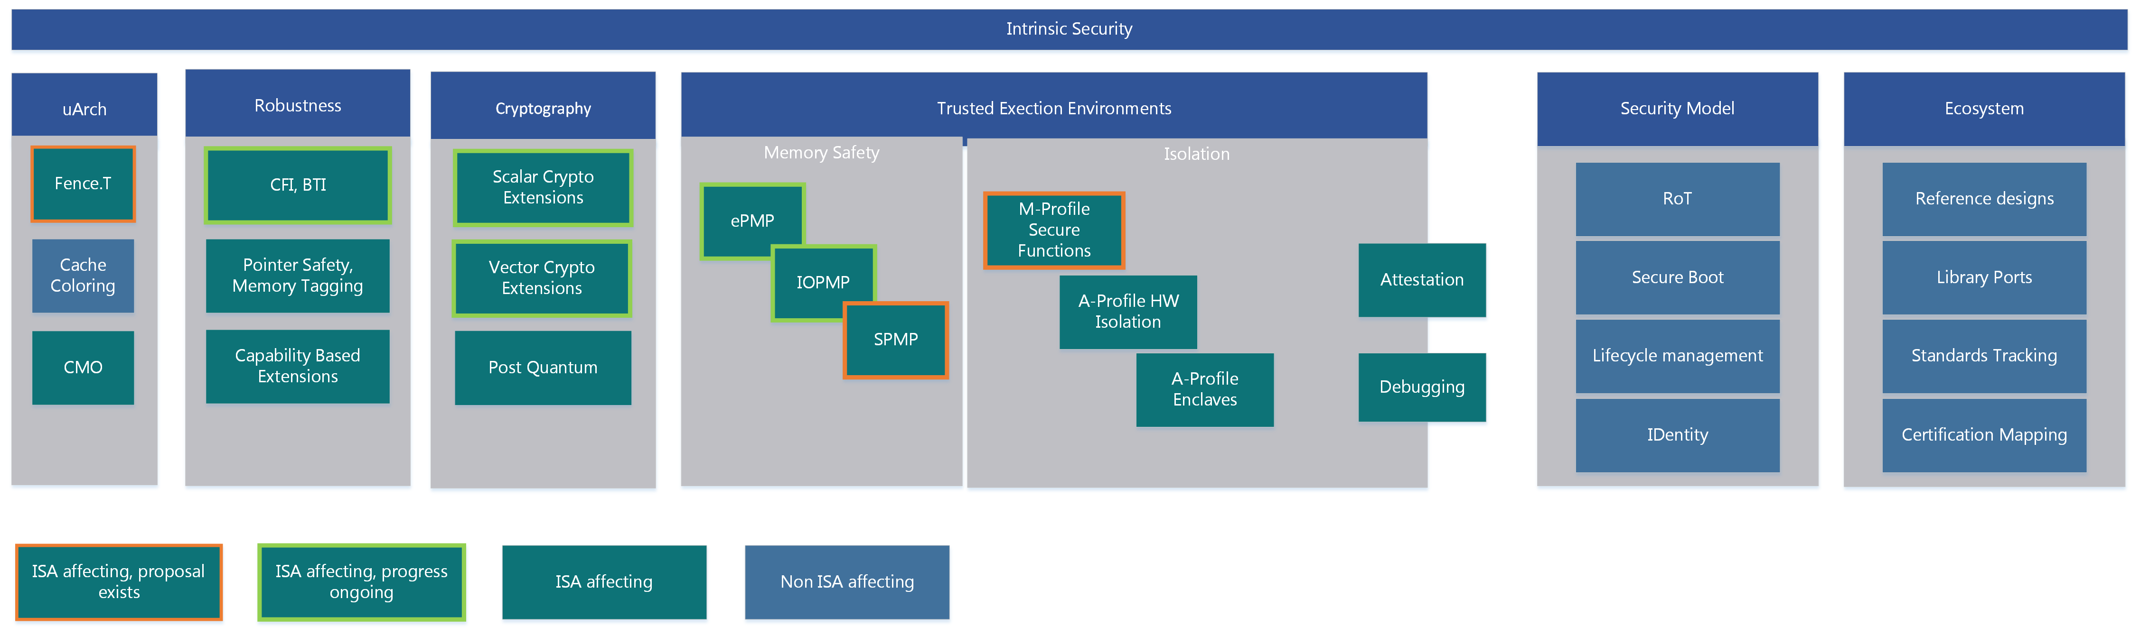

Slide 11
Current documents for review/ collaboration
Please review/ contribute to RISC-V Zero Trust Platform Security Model
https://docs.google.com/document/d/1TRHhsGiB5W4K8M7I4ef40mOPErTb9sv/edit#heading=h.gjdgxs
Please review/ contribute to RISC-V AP-TEE Proposal
https://github.com/riscv-admin/trusted-computing/blob/main/meetings/23-11-2021/11-23-2021%20RVI%20Discussion%20on%20Scalable%20AP-TEE%20for%20RISC-V.pdf
(AR: Ravi to convert this to google document for collaboration)
Please review/ contribute to Confidential VM Proposal
https://docs.google.com/document/d/1ME7THEF9JWuFqwm75x586y3wzhPeXahK8keLcgjZYG8/edit#heading=h.rdbq3ygwk878

Slide 12
Agenda
Finish up last weeks threat model and AP-TEE proposal outline – Ravi (25 mins)
Review the CVM proposal – Dong/ Dingji (25 mins)
RISC-V Platform Security Model document discussion – Suresh (10 mins)

Slide 13
Thank You

